Slide 1

LET US C
BY YASHAVANT KANETKAR
CH 10 Q[B]
CH 10 Q[A]
CHAPTER 10 SOLUTIONS
RECURSION

Slide 2
CHAPTER 10 SOLUTIONS
RECURSION
Q[A] What will be the output of the following programs:
CH 10 Q[A]
(a)
#include <stdio.h>
int main()
{
int i = 0;
i++;
if (i <= 5)
{
printf("C adds wings to your thoughts\n");
exit(0);
main();
}
return 0;
}
(b)
#include <stdio.h>
int main()
{
printf("C to it that C survives\n");
main();
return 0;
}
CH 10 Q[C]
CH 10 Q[B]
DEAR CODING
BOOK: LET US C
BY YASHAVANT KANETKAR

Slide 3

CHAPTER 10 SOLUTIONS
RECURSION
(a)
#include <stdio.h>
int main()
{
printf("C to it that C survives\n");
main();
return 0;
}
CH 10 Q[A](a)
👩‍💻 Output:
✍️ Recursive call always leads to an infinite loop. To avoid this, the function must have a conditional statement that stops the recursion.
DEAR CODING
…
BOOK: LET US C
BY YASHAVANT KANETKAR

Slide 4

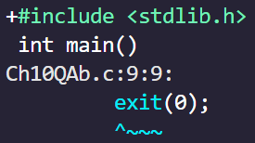
CHAPTER 10 SOLUTIONS
RECURSION
(b)
#include <stdio.h>
int main()
{
int i = 0;
i++;
if (i <= 5)
{
printf("C adds wings to your thoughts\n");
exit(0);
main();
}
return 0;
}
👩‍💻 Output:
CH 10 Q[A](b)
✍️ exit function is defined in stdlib.h header file. It must be included in the program.
DEAR CODING
BOOK: LET US C
BY YASHAVANT KANETKAR

Slide 5

CHAPTER 10 SOLUTIONS
RECURSION
(b)
#include <stdio.h>
#include <stdlib.h>
int main()
{
int i = 0;
i++;
if (i <= 5)
{
printf("C adds wings to your thoughts\n");
exit(0);
main();
}
return 0;
}
👩‍💻 Output:
CH 10 Q[A](b)
✍️ exit function is defined in stdlib.h header file. It must be included in the program.
DEAR CODING
BOOK: LET US C
BY YASHAVANT KANETKAR

Slide 6
CHAPTER 10 SOLUTIONS
RECURSION
Q[B] Attempt the following:
(a) A 5-digit positive integer is entered through the keyboard, write a recursive and a non-recursive function to calculate sum of digits of the 5-digit number.
CH 10 Q[B](a)
DEAR CODING
BOOK: LET US C
BY YASHAVANT KANETKAR

Slide 7
CHAPTER 10 SOLUTIONS
RECURSION
Q[B] Attempt the following:
(b) A positive integer is entered through the keyboard, write a program to obtain the prime factors of the number. Modify the function suitably to obtain the prime factors recursively.
CH 10 Q[B](b)
DEAR CODING
BOOK: LET US C
BY YASHAVANT KANETKAR

Slide 8
CHAPTER 10 SOLUTIONS
RECURSION
Q[B] Attempt the following:
(c) Write a recursive function to obtain the first 25 numbers of a Fibonacci sequence. In a Fibonacci sequence the sum of two successive terms gives the third term. Following are the first few terms of the Fibonacci sequence:
1 1 2 3 5 8 13 21 34 55 89...
CH 10 Q[B](c)
DEAR CODING
BOOK: LET US C
BY YASHAVANT KANETKAR

Slide 9
CHAPTER 10 SOLUTIONS
RECURSION
FIBONACCI SEQUENCE
CH 10 Q[B](c)
0 1 1 2 3 5 8 13 21 34 55 89...
F(n) = F(n-1) + F(n-2)
nth Fibonacci term = sum of previous two terms
DEAR CODING
BOOK: LET US C
BY YASHAVANT KANETKAR

Slide 10
CHAPTER 10 SOLUTIONS
RECURSION
0 1 1 2 3 5 8 13 21 34 55 89...
CH 10 Q[B](c)
F(n) = F(n-1) + F(n-2)
nth Fibonacci term = sum of previous two terms
Ques: Print the nth Fibonacci term on screen.
nth Fibonacci term Position no.
First Fibonacci term -> 0 n = 0
Second Fibonacci term -> 1 n = 1
Third Fibonacci term -> 1 n = 2
Fourth Fibonacci term -> 2 n = 3
…
DEAR CODING
BOOK: LET US C
BY YASHAVANT KANETKAR

Slide 11








CHAPTER 10 SOLUTIONS
RECURSION
0 1 1 2 3 5 8 13 21 34 55 89...
CH 10 Q[B](c)
F(n) = F(n-1) + F(n-2)
Ques: Print the nth Fibonacci term on screen.
Let n = 3
=> Fourth term, which is 2
DEAR CODING
BOOK: LET US C
BY YASHAVANT KANETKAR

Slide 12
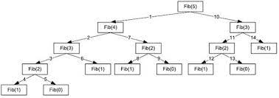
CHAPTER 10 SOLUTIONS
RECURSION
CH 10 Q[B](c)
DEAR CODING
BOOK: LET US C
BY YASHAVANT KANETKAR

Slide 13
CHAPTER 10 SOLUTIONS
RECURSION
Q[B] Attempt the following:
(d) A positive integer is entered through the keyboard, write a function to find the binary equivalent of this number:
(1) Without using recursion
(2) Using recursion
CH 10 Q[B](d)
DEAR CODING
BOOK: LET US C
BY YASHAVANT KANETKAR

Slide 14
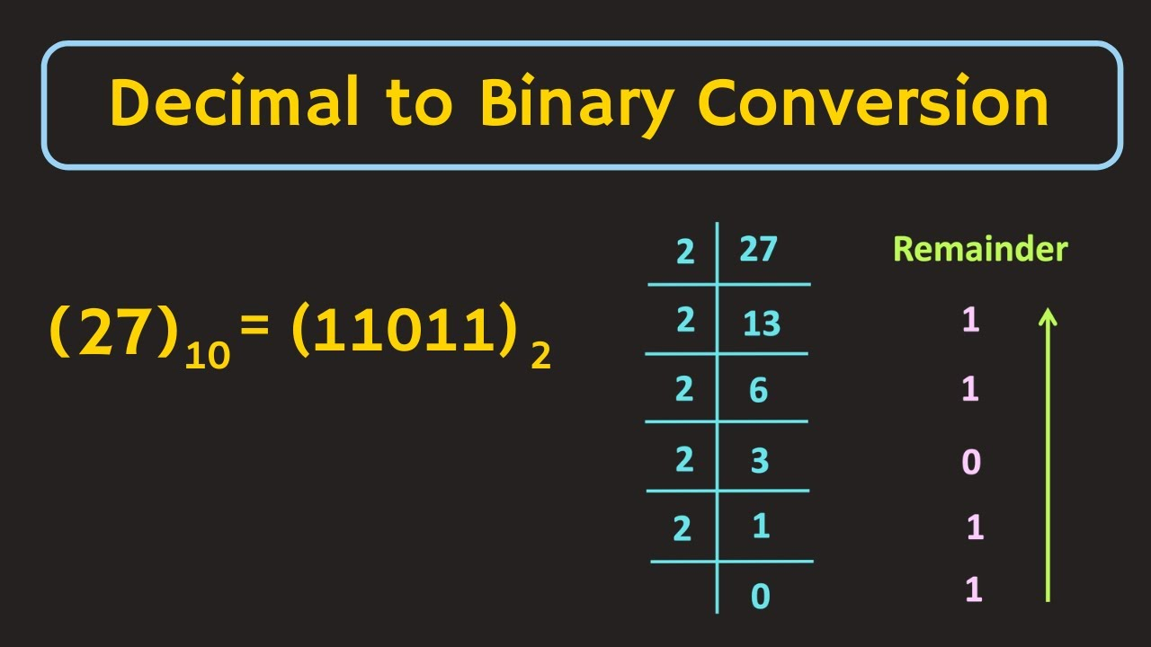
CHAPTER 10 SOLUTIONS
RECURSION
CH 10 Q[B](d)
DEAR CODING
BOOK: LET US C
BY YASHAVANT KANETKAR

Slide 15
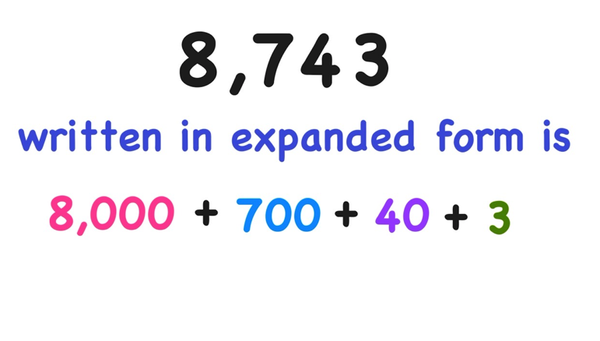
CHAPTER 10 SOLUTIONS
RECURSION
CH 10 Q[B](d)
DEAR CODING
BOOK: LET US C
BY YASHAVANT KANETKAR

Slide 16
CHAPTER 10 SOLUTIONS
RECURSION
Q[B] Attempt the following:
(e) Write a recursive function to obtain the running sum of first 25 natural numbers.
CH 10 Q[B](e)
DEAR CODING
BOOK: LET US C
BY YASHAVANT KANETKAR

Slide 17
LET US C
BY YASHAVANT KANETKAR
CH 11 Q[B]
CH 11 Q[C]
CH 11 Q[A]
CHAPTER 11 SOLUTIONS
DATA TYPES REVISITED

Slide 18


🔴Let me create amazing coding tutorials for you forever!🙂
👇👇👇👇👇👇👇👇👇👇👇👇👇👇👇👇👇👇
👉 SUBSCRIBE 🤛
CH 11 Q[C]
CH 11 Q[A]
CHAPTER 11 SOLUTIONS
DATA TYPES REVISITED
CH 11 Q[B]
Thanks for your valuable time!

Slide 19
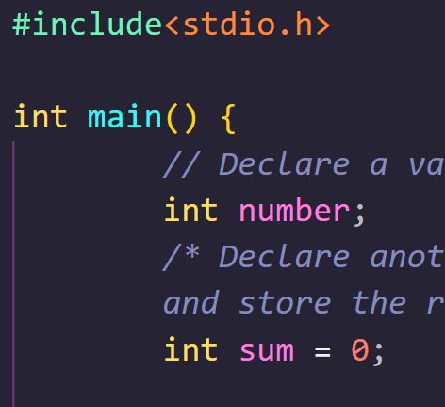
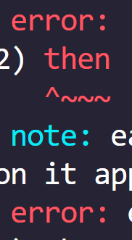

DEAR CODING

